Slide 1

Google Play Store Data Analysis
By Elvis Kwabena Asare Nkrumah

Slide 2

Project Description:
This data analysis project aims to explore and derive insights from a Google Play Store Apps Dataset. The dataset includes details such as app names, categories, user ratings, reviews, sizes, installations, pricing, content ratings, genres, and last update dates.
The dataset used in this analysis was obtained from https://www.kaggle.com/datasets/lava18/google-play-store-apps. The data was webscraped from Google Play Store over a specified period and is intended for research and analytical purposes.
The primary objective is to uncover trends that can inform app developers, marketers, and users.

Slide 3
Key questions:
What are the total numbers of apps in each category?
How many apps are free and paid?
What are the top 10 popular apps by their category and prices?
Does the average ratings of apps by their content rating affect the number of installs?
What category of apps had the highest number of reviews?

Slide 4
Findings & Insights

Slide 5
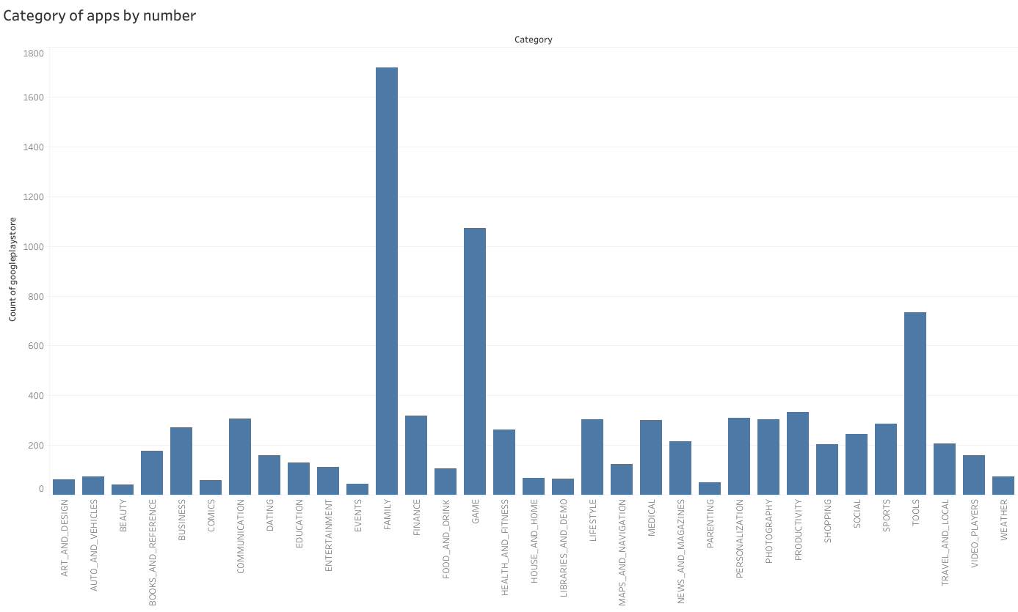
What are the total numbers of apps in each category?
Add visualizations here

Slide 6
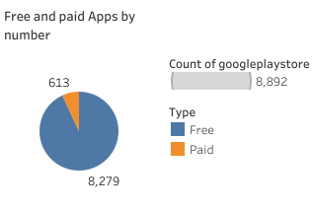
2. How many apps are free and paid?
This distribution suggests that free apps significantly outnumber paid apps, which is a common trend in many app marketplaces.
The ratio of free to paid apps can have implications for various analyses, such as understanding user engagement, revenue generation, and competition within different app categories.

Slide 7
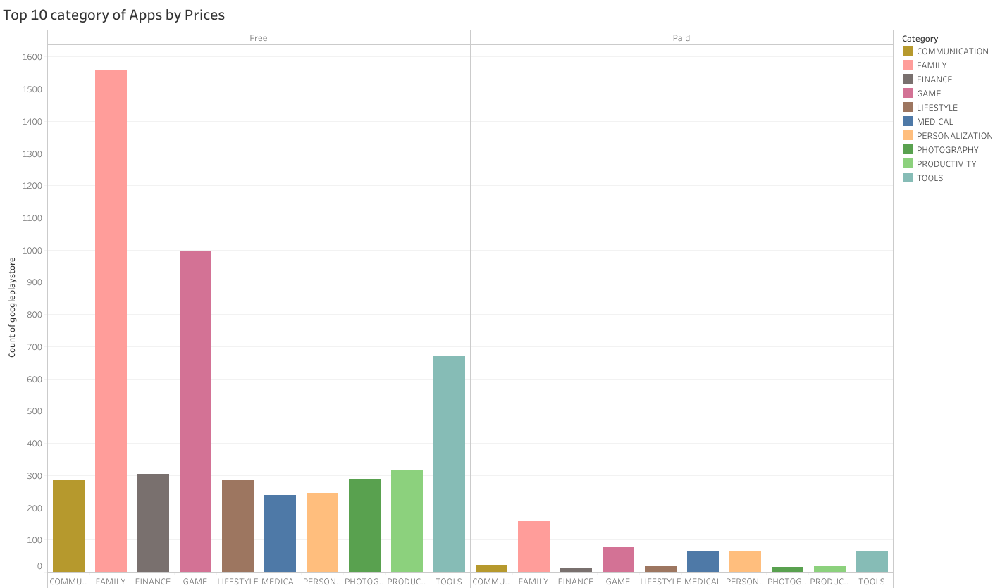
3. What are the top 10 popular apps by their category and prices?
The family category may indicate a strong demand for family-related courses, potentially making it an attractive market for content creators or educational platforms.
The Games category ranks second both in paid and free apps suggesting that it may have high monetization potential and user engagement

Slide 8
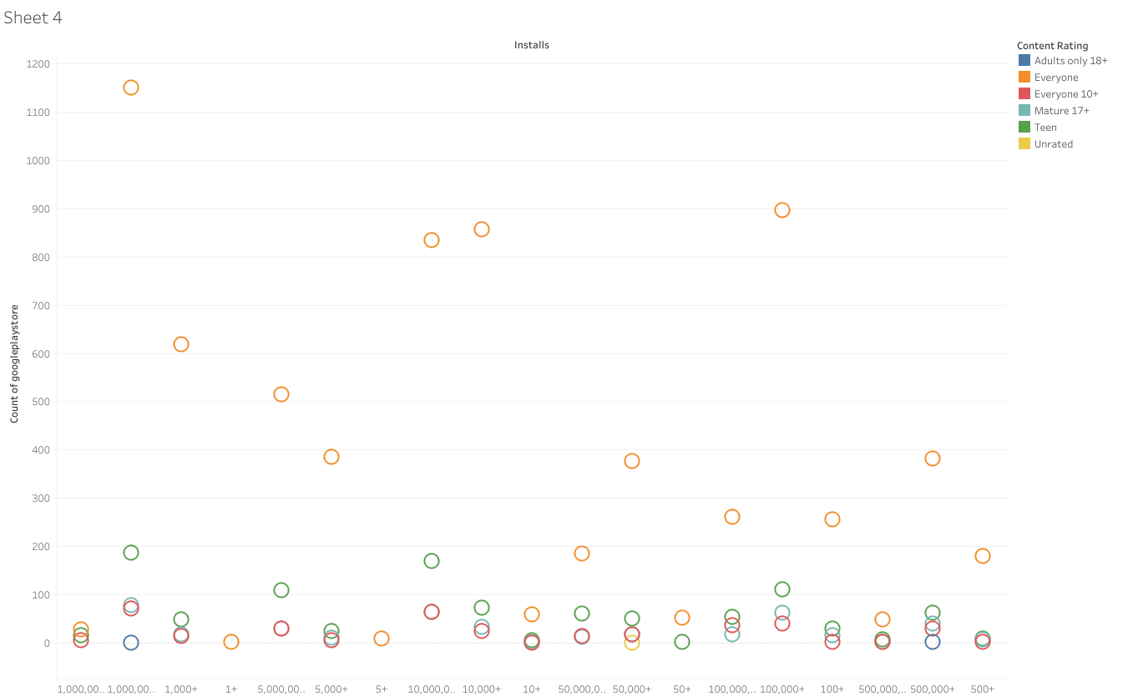
4. Does the content ratings of apps affect the number of installs?
Apps for Everyone are suitable for a wide audience, making them inclusive and accessible to users of all ages due to their high number of installs and a high number of apps in that content rating

Slide 9
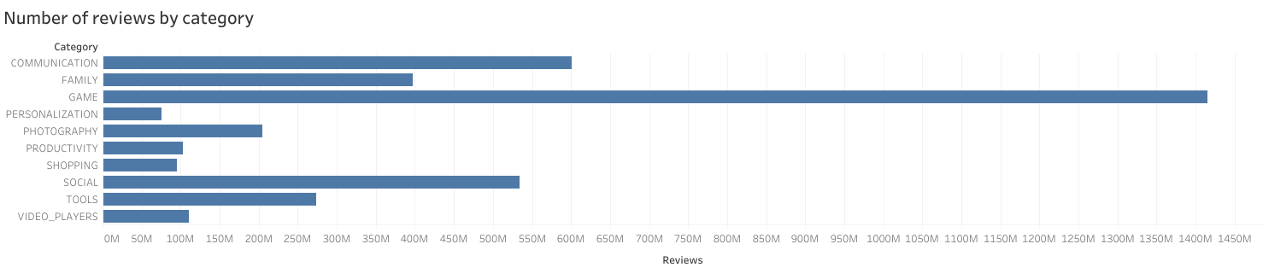
5. What category of apps had the highest number of reviews?
The high number of reviews for games indicates that users are actively engaging with and expressing their opinions about gaming apps. This high level of engagement can be attributed to the interactive and immersive nature of games.

Slide 10
Summary

Slide 11
Summary of findings:
Positive User Experience:
The high number of installations often indicates that users appreciate these apps for their reliability, quality, and content appropriateness. This leads to positive user experiences and contributes to the apps' popularity.
User Engagement:
The high number of reviews for gaming apps suggests significant user engagement and interaction with gaming applications. Users are actively providing feedback and reviews for these apps, indicating a strong gaming community and user-driven content evaluation.
Category Popularity:
The Family category of apps is the most prominent among both free and paid courses. It has the highest number of courses compared to other categories. This finding suggests a strong demand for family-related educational content within your dataset.

Slide 12
Actions & Recommendations

Slide 13
Recommended actions:
Product recommendations:
Given the dominance of the Games category in paid courses, consider incorporating gamification elements into your educational content. Gamification can enhance engagement and make learning more interactive and enjoyable.
Consider expanding the range of courses within the Family category to cater to diverse interests and age groups. This can include courses for parents, children, teenagers, and extended family members. Providing a variety of content can attract a broader audience.
Marketing recommendations:
Use targeted marketing campaigns to reach audiences interested in "Family" and "Games" content. Social media advertising, email marketing, and content marketing can be effective for reaching these specific audiences.

Slide 14
Thank you!

